Slide 1
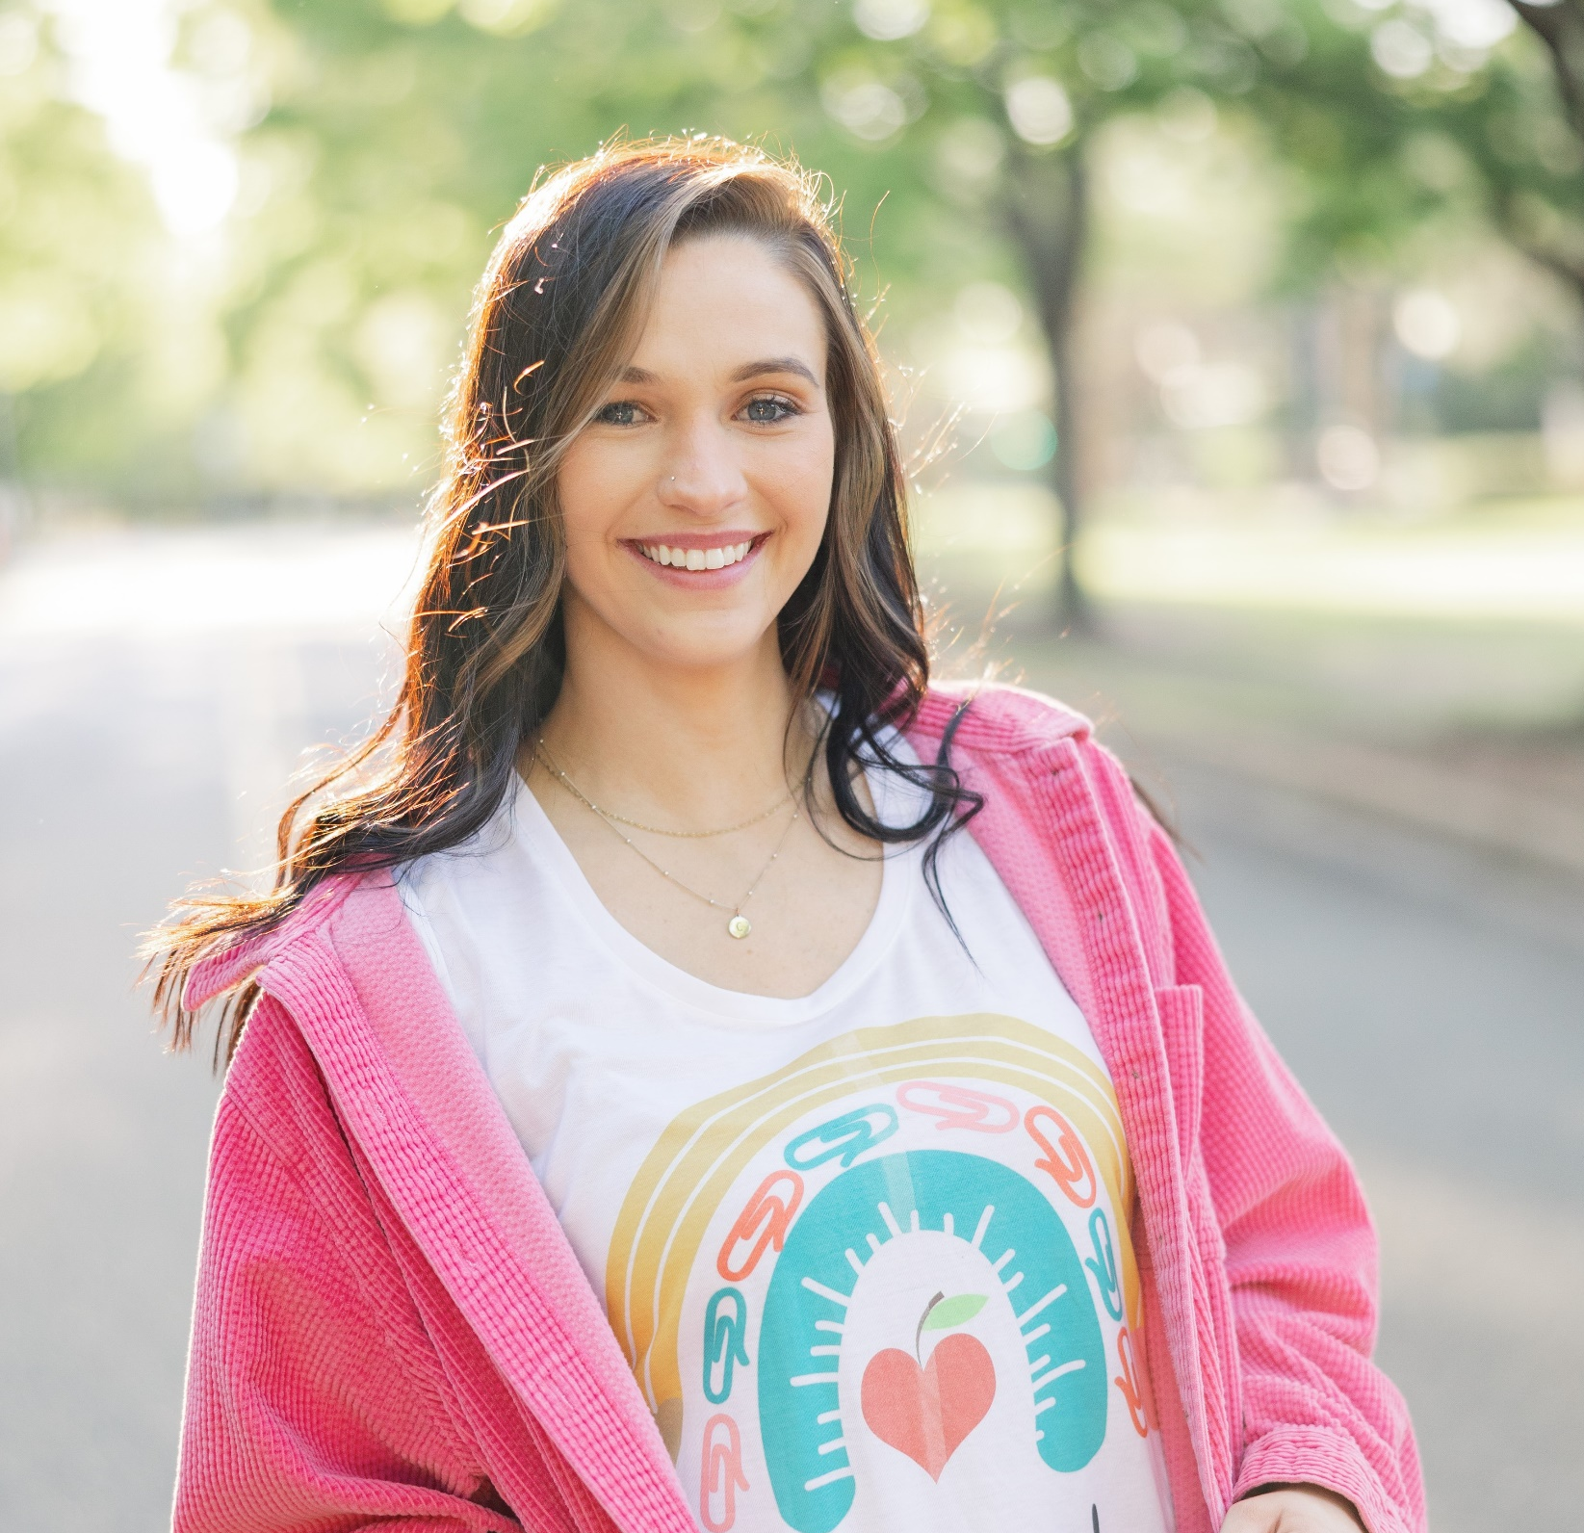
A Few of my Favorite Things
About Mrs. Fernandes
Pasta
Cows
Diet Mountain Dew
My dogs, Tucker & Ruger
Lake Days
Hi! My name is Ms. Fernandes, I am so excited to be your first-grade teacher this year! I graduated from Lander University with a bachelor degree in Early Education! This will be my first-year teaching! We are going to have so many awesome adventures this year! I can’t wait to get to know both you and your student! This year
is sure to be the best yet!
Contact Info
Email Fernajo@boe.richmond@k12.ga.us
I will also be adding everyone by phone number to Class Dojo!

